Slide 1

Utah Em
Alabama Provider Transformation Workshop
March 3, 2020
Lakeshore Rehabilitation Facility-ADRS,
201 London Parkway, Suite 450
Homewood, AL 35211

Slide 2
Genni Sasnett
COO of SJCS, headquartered in Washington, DC
Started work in SE in 1987
Collaborated with team to conceptualize, plan and implement transformation
Agency become 100% community based across multiple states and in different environments – urban, suburban and rural
More than one transformation experience at SJCS
SME for Office of Disability Employment Policy, The Institute for Community Inclusion, University of Boston (ICI), & numerous states

Slide 3

Thomas F. Wilds
“Tom”
50 + years in the disability field
Attendant, Psychiatric Aide & Sp. Ed. Aide
Special Ed. Teacher & Voc. Rehab. Teacher
State & national TA for deinstitutionalization &
the integration of preschool & school age
children with disabilities
33 years as President/CEO of historic non-profit
that transformed from center-based services to integrated community-based & employment services
6 years SME for Depts. of Labor & Justice, provider associations, DD Councils & numerous states

Slide 4
DAY 1-Tuesday, March 3, 2020
Agenda
9:00 am - 10 am Registration & Coffee
10:00 am – 10:15 am Welcome and Introductions
                Byron White - Alabama Department of Mental Health Division of Developmental Disabilities
10:15 am – 11:00 am Building the Stage for Provider Transformation
Genni Sasnett, SME
11:00 am - Noon Leadership: Setting the Tone for Change
Thomas Wilds, SME
Noon-1:00 pm Lunch Break (provided)

Slide 5
Afternoon Agenda
1:00 pm - 2:00 pm Individualized Supports Genni Sasnett
2:00 pm - 2:45 pm Agency Transformation Planning Thomas Wilds
2:45 pm -3:30 pm Staff Development and Support Genni Sasnett
3:30 am- 4:30 pm Getting Started Genni Sasnett
Adjourn

Slide 6


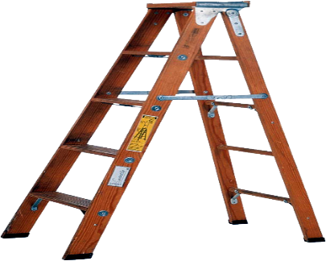

Building the Stage for Transformation
Alabama Provider Transformation Workshop
Lakeshore Rehabilitation Facility-ADRS
201 London Parkway, Suite 450
Homewood, AL 35211
This Photo by Unknown Author is licensed under CC BY-NC

Slide 7
Its been a long time coming…….

Slide 8

1970s
Public Law 94-142
“least restrictive environment”
Deinstitutionalization
“in” though not yet “of” the community
Notes:
Required all public schools accepting federal funds to provide equal access to education for children with physical and mental disabilities
Public schools required to evaluate handicapped children and create an educational plan emulating as closely as possible the educational experience of non-disabled students
PL 94-142 also contains a provision that disabled students should be placed in the least restrictive environment - one that allows the maximum possible opportunity to interact with non-impaired students
Requires that special education students receive school to adult life (work) services
A number of class action lawsuits (Willowbrook, Pennhurst, Forest Haven, Partlow) were filed alleging that the that the poor living conditions and treatment residents had to endure was a violation of their constitutional rights. Many suits were won and people began to move from institutional care to community living and day services.
ICFs/MR (now ICF/IDD)
Group homes
Center based day programs
Sheltered workshops
People began to be IN the community but unfortunately in many cases not yet OF the community

Slide 9

1980s
Medicaid Waiver Programs Established
“Supporting community-based services”
Supported Employment Expands
“Place & train”
Notes:
Supported employment means:
Competitive employment in an integrated setting with ongoing support services for individuals with the most severe disabilities —
For whom competitive employment has not traditionally occurred or for whom competitive employment has been interrupted or intermittent as a result of a severe disability; and
Who, because of the nature and severity of their disabilities, need intensive supported employment services from the designated State unit and extended services after transition in order to perform this work;
Transitional employment for individuals with the most severe disabilities due to mental illness
A place and train approach rather than the traditional train and place model.

Slide 10

1990s
ADA
“Civil Rights Legislation”
OLMSTEAD DECISION
“Reinforcing ADA”
Notes:
Affirms Title II of the ADA
Prohibits unnecessary segregation
Requires that services be provided in the “most integrated setting” appropriate to individual’s needs
Segregated settings include, but are not limited to…congregate settings populated exclusively or primarily with individuals with disabilities [and] settings that provide for daytime activities primarily with other individuals with disabilities

Slide 11


2000s
Employment First
“the framework for policy shift towards community employment”
Customized Employment
“making employment a reality for all”
Notes:
Customized employment is based on an individualized match between the strengths, conditions, and interests of a job candidate and the identified business needs of an employer.
Customized employment will often take the form of:
Task reassignment: Some of the job tasks of incumbent workers are reassigned and a new job description is negotiated based on current, unmet workplace needs.
Job carving: An existing job description is modified — containing one or more, but not all, of the tasks from the original job description.
Job sharing: Two or more people share the tasks and responsibilities of a job based on each other's strengths.
Self-employment - Allows for an individual to receive assistance in the creation of an independently owned small business based on the strengths and dreams of an individual and the unmet needs of a local market.

Slide 12



2010s
CMS Settings Rule
“full access to the greater community”
Dept. of Justice Actions
“remedying failure to provide access”
WIOA
“ potential for significant advancement in competitive integrated employment”
Notes:
Setting is integrated in and supports full access to the greater community
U.S. v. Rhode Island:
State of Rhode Island violated the ADA and Olmstead by failing to serve individuals with I/DD in the most integrated day activity service setting appropriate for their needs, and by placing transition-age youth at serious risk of segregation.
Relief for 3,250 individuals with intellectual and developmental disabilities.
Opportunities for real employment in the community at competitive wages, and integrated day activities for non-work hours.
Investigation found that the state has over-relied on segregated service settings to the exclusion of integrated alternatives.
Lane v. Kitzhaber/U.S. v. Oregon:
Court decision on motion to dismiss found that ADA and Olmstead applies to all government services, programs and activities, including employment. Rejected argument that only applies to residential services and programs.
The agreement calls for 1,115 people in sheltered workshops to receive jobs in the community at competitive wages over the next seven years. In addition, 7,000 people will receive employment services that will afford them the opportunity to work in the community, including at least 4,900 youth ages 14 to 24 years old, who are exiting school.
Closed the front door to workshops.
Limitations on sub-minimum wage: A new section has been added to the Rehabilitation Act, Section 511. It requires (as of 2016) a series of steps before an individual under the age of 24 can be placed in a job paying less than minimum wage (almost all of which are positions with community rehabilitation providers in sheltered workshops or enclaves). Section 511 also prohibits schools from contracting with sub-minimum wage providers. Requirement for formal cooperative agreement between
Opportunities to seek employment and work in competitive integrated settings, engage in community life, control personal resources, and receive services in the community to the same degree of access as individuals not receiving Medicaid HCBS
Setting is selected by the individual from among setting options including nondisability specific settings
Excluded options include: settings that have the effect of isolating individuals receiving Medicaid-funded HCBS from the broader community

Slide 13

2020 - Recent Noteworthy Bills in Congress
This Photo by Unknown Author is licensed under CC BY-SA

Slide 14

Transformation to Competitive Employment Act
(HR 873 / S. 260)
A bipartisan and bicameral bill which aims to support states to transition away from sheltered employment, the use of 14(c) certificates, and subminimum wage.

Slide 15


"Raise the Wage" Bill Introduced in Congress
Includes Increase in Minimum Wage & End to Subminimum Wage
The Raise the Wage Act would:
Gradually raise the federal minimum wage from $7.25 to $15 over six years
Index future increases in the federal minimum wage to median wage growth
Guarantees tipped workers are paid at least the full federal minimum wage
Guarantees teen workers are paid at least the full federal minimum wage
End subminimum wage certificates for individuals with disabilities to provide opportunities for individuals
Notes:
The bill currently has 193 co-sponsors in the House and 30 co-sponsors in the Senate.

Slide 16
Subminimum Wage and 14(c)
11 States Introducing Legislation:
MT (HB588) – Prohibits subminimum wages for workers with disabilities
IL (HB3340) – Develop plan to phase out subminimum wage for workers with disabilities by 2024
NC (HB 366) – Raises wages over 5 years and ends subminimum for workers with disabilities
CT (H6739) – Prohibits employers from paying workers with disabilities less than state minimum wage
NY (S4018) – Eliminates exemptions for workers with disabilities from state minimum wage
KY (SB76) – Phase out of sheltered workshops and 14(c) certificates by 2021
OR (HB2313) – Elimination of subminimum wage & tax credits
HI (SB349; SB789 SD2/HB1191 HD1) – Elimination of subminimum wage; tax credit to offset increase in wages (House bill includes language related to workers with disabilities)
WV (HB2902/S659) – Establish an E1 taskforce and elimination of subminimum wage
WA (SB 5753/HB 1706) – Elimination of subminimum wage
NV City of Reno (A-15) – Elimination of subminimum wage in Reno

Slide 17
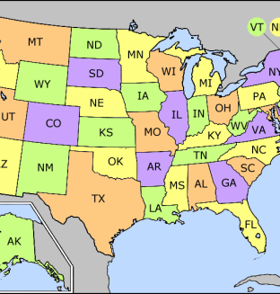
These States Have Legislation Banning or Phasing Out Sub-Minimum Wages
Alaska eliminated subminimum wage through a regulatory change that went into effect on February 16, 2018.
Maryland – HB 420 / SB 417 became law in May 2016 phasing out special wage certificates.
New Hampshire – SB 47 passed in May 2015 banning employers from paying workers with disabilities less than the minimum wage
Vermont – Vermont began moving toward integrated employment in the early 1980s. It closed its last sheltered workshop in 2002.
The city of Seattle, WA passed CB 119220, removing the authority to pay subminimum wage. Washington state allows subminimum wage.
The city of Reno, NV has passed resolution D. 1, that prohibits the payment of subminimum wages.

Slide 18

Laws Precede Culture Change
Laws aren’t the only thing required to make real change
Changes in culture can be slow and can go forward and then regress
Culture change has to be pursued persistently

Slide 19
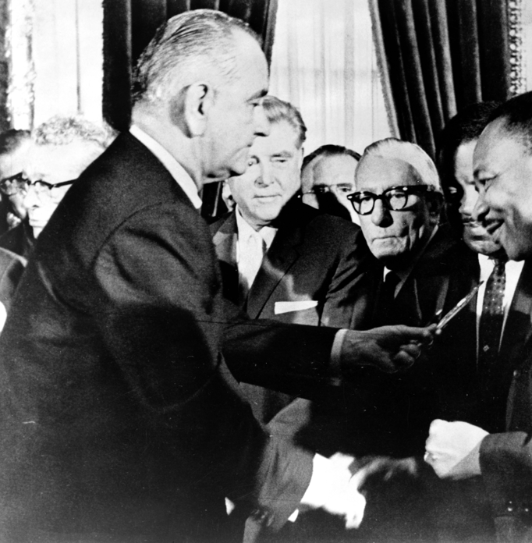
Civil Rights Act of 1964
(55 Years ago)
  Outlaws discrimination based on race, color, religion, sex, or national origin. It prohibits unequal application of voter registration requirements, and racial segregation in schools, employment, and public accommodations

Slide 20

Employment Specifically Cited
The act barred race, religious, national origin and gender discrimination by employers and labor unions, and created an Equal Employment Opportunity Commission with the power to file lawsuits on behalf of aggrieved workers.
This Photo by Unknown Author is licensed under CC BY-NC-ND

Slide 21

Today, May 13, 2019
Promise kept or more work to do?

Slide 22
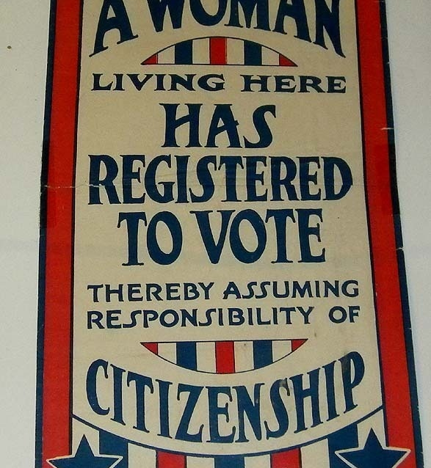
1920 19th Constitutional Amendment
A Woman's Right to Vote
(100 years ago)
Women get the right to vote for the first time
Notes:
1920 married women couldn’t own property and had no legal claim to any money they might earn, and no female had the right to vote
182
1920 married women couldn’t own property and had no legal claim to any money they might earn, and no female had the right to vote
182

Slide 23
Today, May 14, 2019
Promise kept or more work to do?
Notes:
Wage gap of 20%

Slide 24

ADA
Made it a violation of federal law to discriminate against people with disabilities, just as civil rights laws protect people against discrimination on the basis of race, gender, national origin, and religion. Four titles: Employment, State and Local Government, Public Accommodations, Telecommunications, Miscellaneous Provisions

Slide 25
Title I
Employment
Helps people with disabilities access the same employment opportunities and benefits available to people without disabilities.
Applies to employers with 15 or more employees.
Requires employers to provide reasonable accommodations to qualified applicants or employees.
Regulated and enforced by the U.S. Equal Employment Opportunity Commission.
Notes:
A “reasonable accommodation” is a change that accommodates employees with disabilities so they can do the job without causing the employer “undue hardship” (too much difficulty or expense).

Slide 26
Title III
Public Accommodations and Services Operated by Private Entities
Prohibits places of public accommodation from discriminating against individuals with disabilities. Sets the minimum standards for accessibility for alterations and new construction of commercial facilities and privately owned public accommodations.
Directs businesses to make "reasonable modifications" to their usual ways of doing things when serving people with disabilities.
Requires that businesses take steps necessary to communicate effectively with customers with vision, hearing, and speech disabilities.
Regulated and enforced by the U.S. Department of Justice.
Notes:
Aplicability for cb day programs
Public accommodations include privately owned, leased or operated facilities like hotels, restaurants, retail merchants, doctor’s offices, golf courses, private schools, day care centers, health clubs, sports stadiums, movie theaters, and so on.

Slide 27
Today, May 14, 2019
Promise kept or more work to do?

Slide 28

Recognize How Employment
First Fits In a Civil Rights Movement
Work has an equalizing effect
Familiarity breeds acceptance
Seeing productivity changes perceptions
Economic parity is empowering
Laws/rules often precede practice
Cultural change occurs over time

Slide 29

Implications for Service Provision
for Agencies
This Photo by Unknown Author is licensed under CC BY-SA-NC

Slide 30

Competitive integrated employment is a priority
Employment that is well matched to the person makes everyone look good
A poor job match or poor job support does the opposite
The right job for the right worker with the right conditions to make everyone successful

Slide 31

Meaningful Community Engagement is an Imperative
Can’t be achieved in large groups
Can’t be achieved by endless one-shot experiences
Can’t be achieved by staff who don’t believe
Staff need skill to provide just the right support for success

Slide 32

Change in the way we operate is inevitable.

Slide 33

How We See Our Work and Our Jobs Cannot Be the Same
More than a job – it’s a movement.
Inspired staff & managers make things happen, no matter what.
Ultimately our job is to be change agents.

Slide 34
The Reality Check!
Laws have been changing
Expectations have been changing
Our work has been changing
No surprises here!

Slide 35
Summary
Now is the time for great advances in the acquisition of full civil rights for people with disabilities – the culmination of decades of effort
Competitive integrated employment and meaningful community engagement is key to the inclusion of people with disabilities as valued members of society
Perception change is critical to culture change and we all play a significant role in making this happen
We are fortunate to be civil rights workers and advocates for people with disabilities – celebrate your role and recognize your power to promote change!

Slide 36
Questions ?

